Slide 1
Message Channels
Madhu Venkat
Guest Faculty
BITS, WILP

Slide 2
In this segment
Message Channels
Message Channel
Point to Point Channel
Publish-Subscr Channel
Data Type Channel
Invalid Message Channel
Dead Letter Channel
Guaranteed Delivery
Channel Adapter
Messaging Bridge
Message Bus

Slide 3
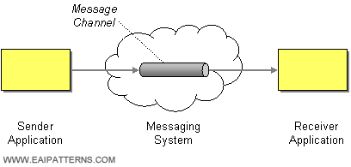
Message Channel
A Message channel is a basic architectural pattern of a messaging system and is used fundamentally for exchanging data between applications. An application can use a channel to make a specific type of data available to any receiver applications that need to consume that type of data.

Slide 4
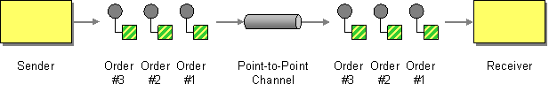
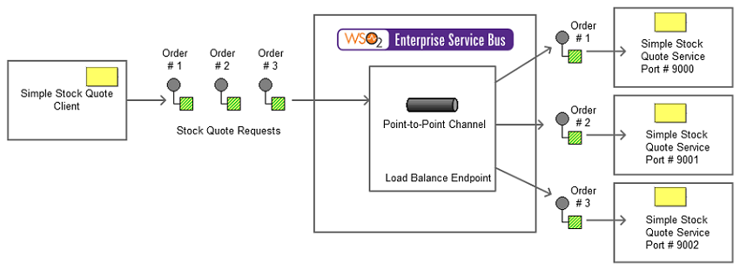
Message Channel
Point to Point Channel
The Point-to-Point Channel EIP ensures that only a single receiver consumes a message (when there are multiple receivers waiting to consume the message).

Slide 5
Message Channel
Point to Point Channel – Example

Slide 6
Message Channel
Point to Point Channel
Point-to-Point EIP (Figure 1) | Point-to-Point Channel Example Scenario (Figure 2)
Sender | Stock Quote Client
Receiver | Three instances of the Stock Quote service
Point to Point Channel | Load-balance Endpoint
Order | Stock Quote Requests

Slide 7
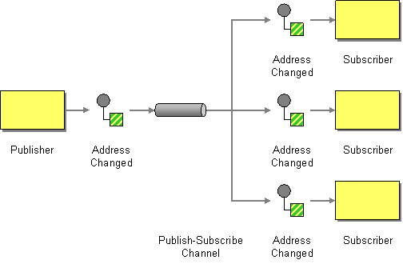
Message Channel
Publish-Subscribe Channel
The Publish-Subscribe Channel EIP receives messages from the input channel, and then splits and transmits them among its subscribers through the output channel. Each subscriber has only one output channel.

Slide 8
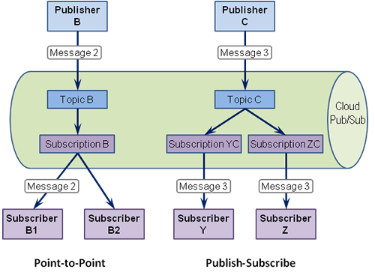
Message Channel
Publish-Subscribe Channel - Example
In this example, both Subscriber Y and Subscriber Z each receive a copy of Message 3 as they are subscribing to the same Topic C, but through separate subscriptions.

Slide 9
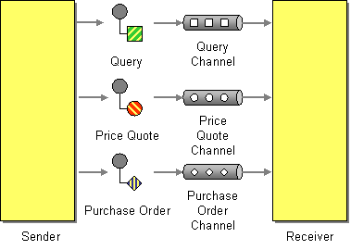
Message Channel
Datatype Channel
This EIP creates a separate channel for each type of data so that all the messages on a given channel will contain the same data type. The sender, who knows the data type, should select the appropriate channel on which to send the message. The receiver identifies the type of data a message contains, based on the channel in which it is received.

Slide 10
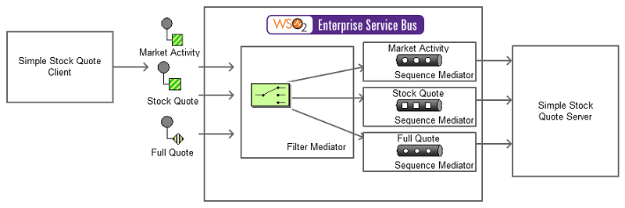
Message Channel
This example scenario depicts a Stock Quote service deployed in Axis2 server. It offers several service operations to the user. The ESB uses the filter mediator to identify each action that is specified by the sender and diverts the request into the appropriate sequence. Each sequence acts as a separate channel. The sender experiences the decomposition of channels through a log message indicated by the ESB. There will be a different log message for each operation the sender requests.
Datatype Channel - Example
This EIP creates a separate channel for each type of data so that all the messages on a given channel will contain the same data type. The sender, who knows the data type, should select the appropriate channel on which to send the message. The receiver identifies the type of data a message contains, based on the channel in which it is received.

Slide 11
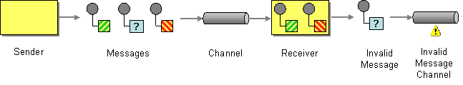
Message Channel
Invalid Message Channel
The Invalid Message Channel EIP pattern allows administrators to define an error indication that appears when an endpoint fails to process a request.

Slide 12
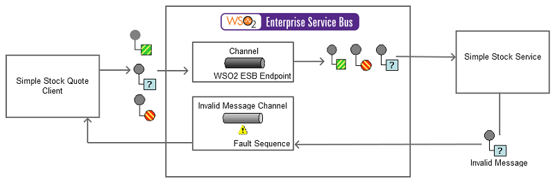
Message Channel
Invalid Message Channel - Example
The example scenario creates a deliberate error situation to demonstrate how the ESB handles errors on message failures.

Slide 13
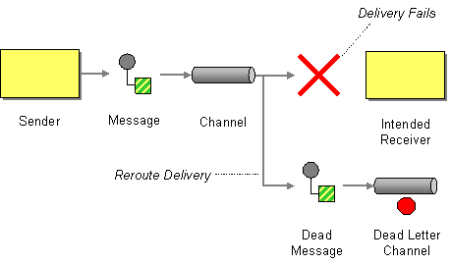
Message Channel
Dead Letter Channel
The Dead Letter Channel (DLC) EIP outlines how messaging systems can handle messages that cannot be delivered to the recipient. Due to system/network failures or failures at the recipient's end, messages sometimes do not get delivered to the target. In such cases, the messaging system can deliver the message to a DLC.

Slide 14
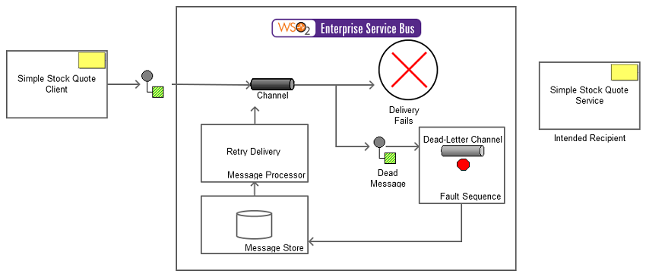
Message Channel
Dead Letter Channel - Example
This example takes a proxy service called StockQuoteProxy, which fronts a service by the name SimpleStockQuoteService. As long as the SimpleStockQuoteService is running, the clients calling StockQuoteProxy service got response. But if the SimpleStockQuoteService is down or a failure occurs while trying to send message to the SimpleStockQuoteService, the faultsequence will get involved and the message will be delivered to the dead letter channel.

Slide 15
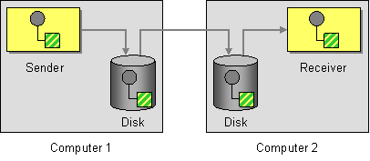
Message Channel
Guaranteed Delivery Channel
The Guaranteed Delivery EIP ensures safe delivery of a message by storing it locally and transmitting it to the receiver's data store. Even when the receiver is offline, the EIP ensures that the message goes through when the receiver comes online.

Slide 16
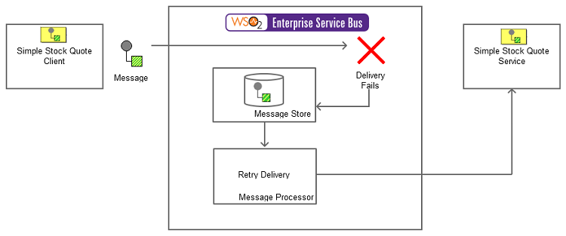
Message Channel
Guaranteed Delivery Channel - Example
This example is a stock quote service where a stock quote request is sent to a specific endpoint when the receiver is offline. An Axis2 server acts as the receiver. The ESB stores the request message in a JMS message store provided by the ESB. In this scenario, a Message Broker acts as the JMS message store. Here, the Message Broker can either be the WSO2 Message Broker or ActiveMQ.

Slide 17
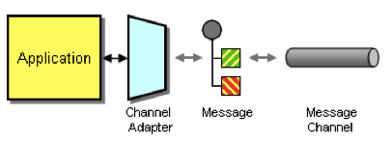
Message Channel
Channel Adapter Channel
Channel Adapter accesses an application's API or data and publishes messages on a channel based on this data. Also, it receives messages and invokes functionality inside the application.

Slide 18
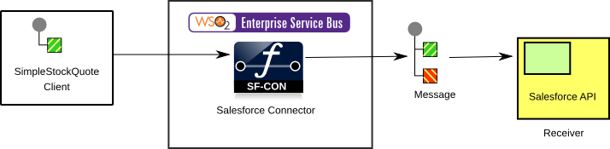
Message Channel
Channel Adapter Channel - Example
This example demonstrates WSO2 ESB's Salesforce connector transferring a message coming from a stock quote client to Salesforce API and then sends the queried response that comes from Salesforce back to the client.

Slide 19
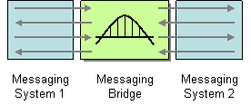
Message Channel
Messaging Bridge Channel
The Messaging Bridge EIP facilitates the connection between messaging systems and replicates messages between them by transforming message formats from one system to the other.

Slide 20
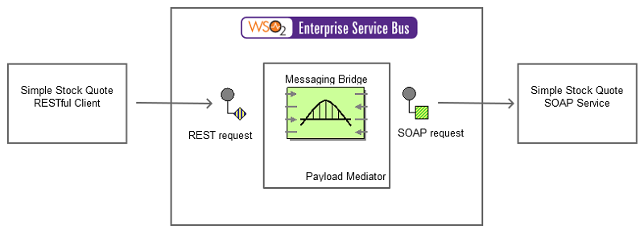
Message Channel
Messaging Bridge Channel - Example
This example illustrates the ESB as a message bridge, which accepts a REST message from the client, transforms the REST message to SOAP format, and sends the SOAP message to the back-end Axis2 server.

Slide 21
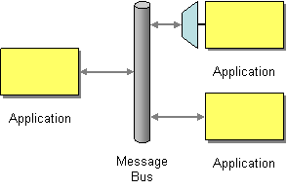
Message Channel
Messaging Bus Channel
The Message Bus EIP enables separate applications to work together in a decoupled manner so that applications can be easily added or removed without affecting each other. This approach makes maintenance and testing smoother, since editing or removing an application will not affect the functionality of any other application.

Slide 22
Thank You!
In our next session:
Message Routing

